Slide 1
Windows Server 2022

Slide 2
Installing Windows Server 2022
Install VMware work station pro 17
Install Windows Server 2022 ISO from Microsoft website.
Make sure to follow the steps of the installation from the following Website:
https://thesecmaster.com/blog/step-by-step-procedure-to-install-windows-server-2022-on-vmware-workstation
Watch the attached video in Week # 2 on teams and on the E-Learning for more assistance.

Slide 3
Starting Windows Server (Server Manager)
Install Vmware tools.
Changing Computer Name (computer Name)
Changing IP address (ncpa.cpl)
Setting Firewall
Refresh each 10 Mints.

Slide 4
Active Directory
Domain accounts are used by organizations with large networks that have users with different levels of privileges and access rights where control is centralized by a domain controller.
Workgroup accounts are intended for small networks on a single LAN or subnet and offer its users greater control over their computer.

Slide 5
Domain Accounts
There are some group policies done by the Domain Controller
Domain Controller is the server that has and applies the rules
User repository: Create users from a center point and this user name can be used to sign into any joined computer in the domain.

Slide 6
Local users and groups on a computer

Slide 7
Create New User

Slide 8
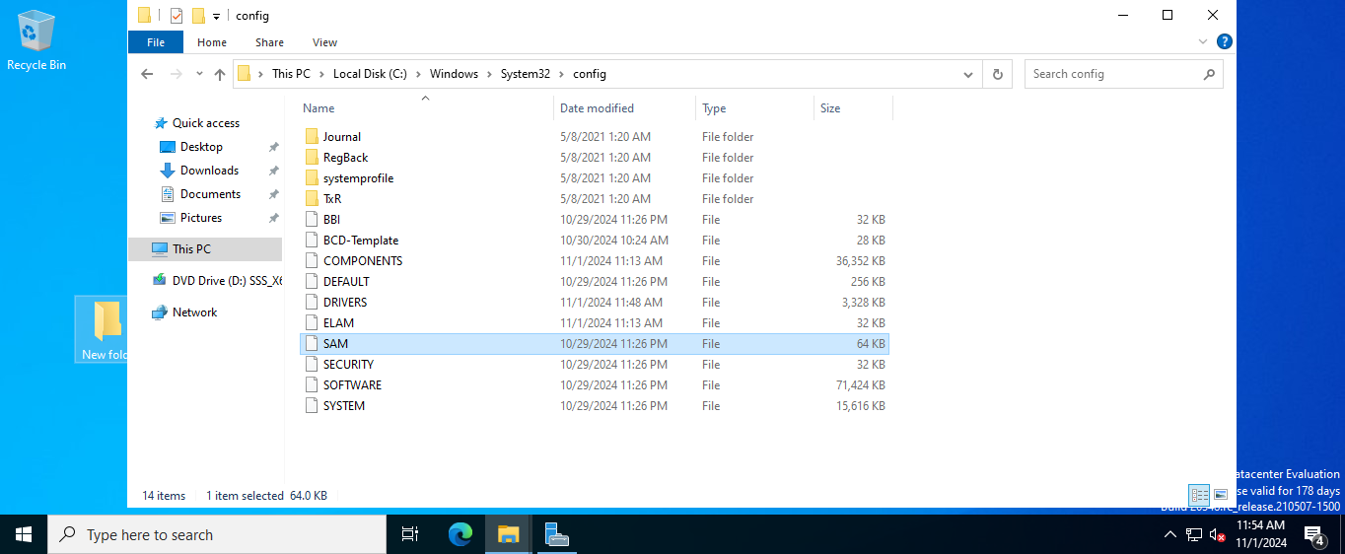
SAM database
C:\Windows\System32\config

Slide 9
Conclusion
Domain: virtual namespace devices and users join to this domain.
Active directory: Set of rules installed on the domain controller to determine the privileges and access rights of each user account.

Slide 10
Add Active Directory
Active directory domain server and its recommended features.
DNS server and its features

Slide 15
Forest
Domain
Philadelphia.local
Additional DC
Primary DC
DC.Philadelphia.local
ADC.Philadelphia.local
Child Domain
Cyber.Philadelphia.local
IT.philadelpha.local
NOS.philadelpha.local
Abc.com
Tree

Slide 20
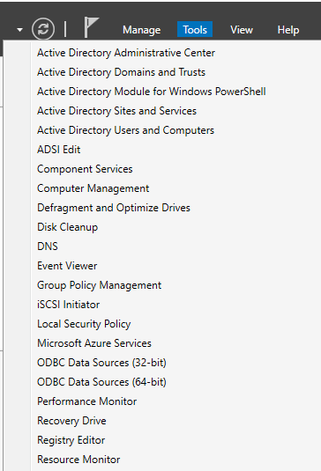

Slide 24
Conclusion
We installed an active directory on a normal device that has windows server operating system. This device is changed to become a Domain Controller after that.

